Slide 1
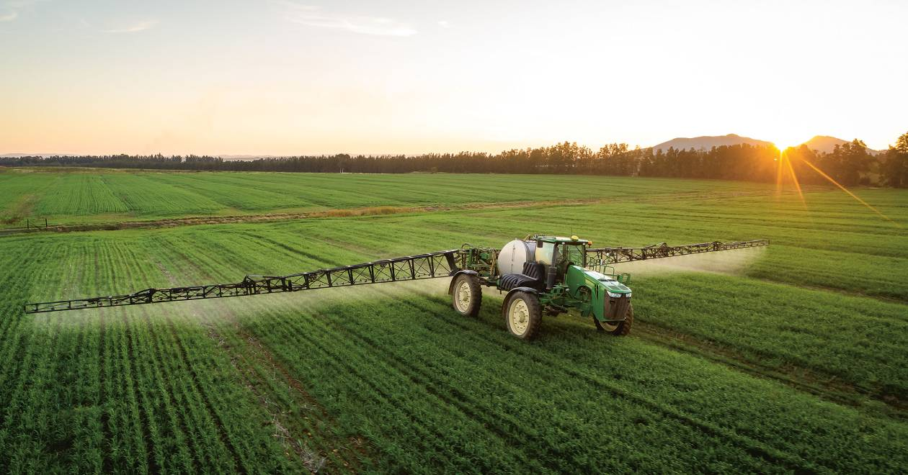
THE GREEN REVOLUTION: A CURSE OR BLESSING TO BIODIVERSITY ?
Group 15

Slide 2
Outline of Presentation
Introduction
Overview of green revolution
Positive Impacts on biodiversity
Negative impacts of the Green Revolution on biodiversity
Balancing the green revolution and biodiversity
A case study
Mitigation strategies
Conclusion

Slide 3
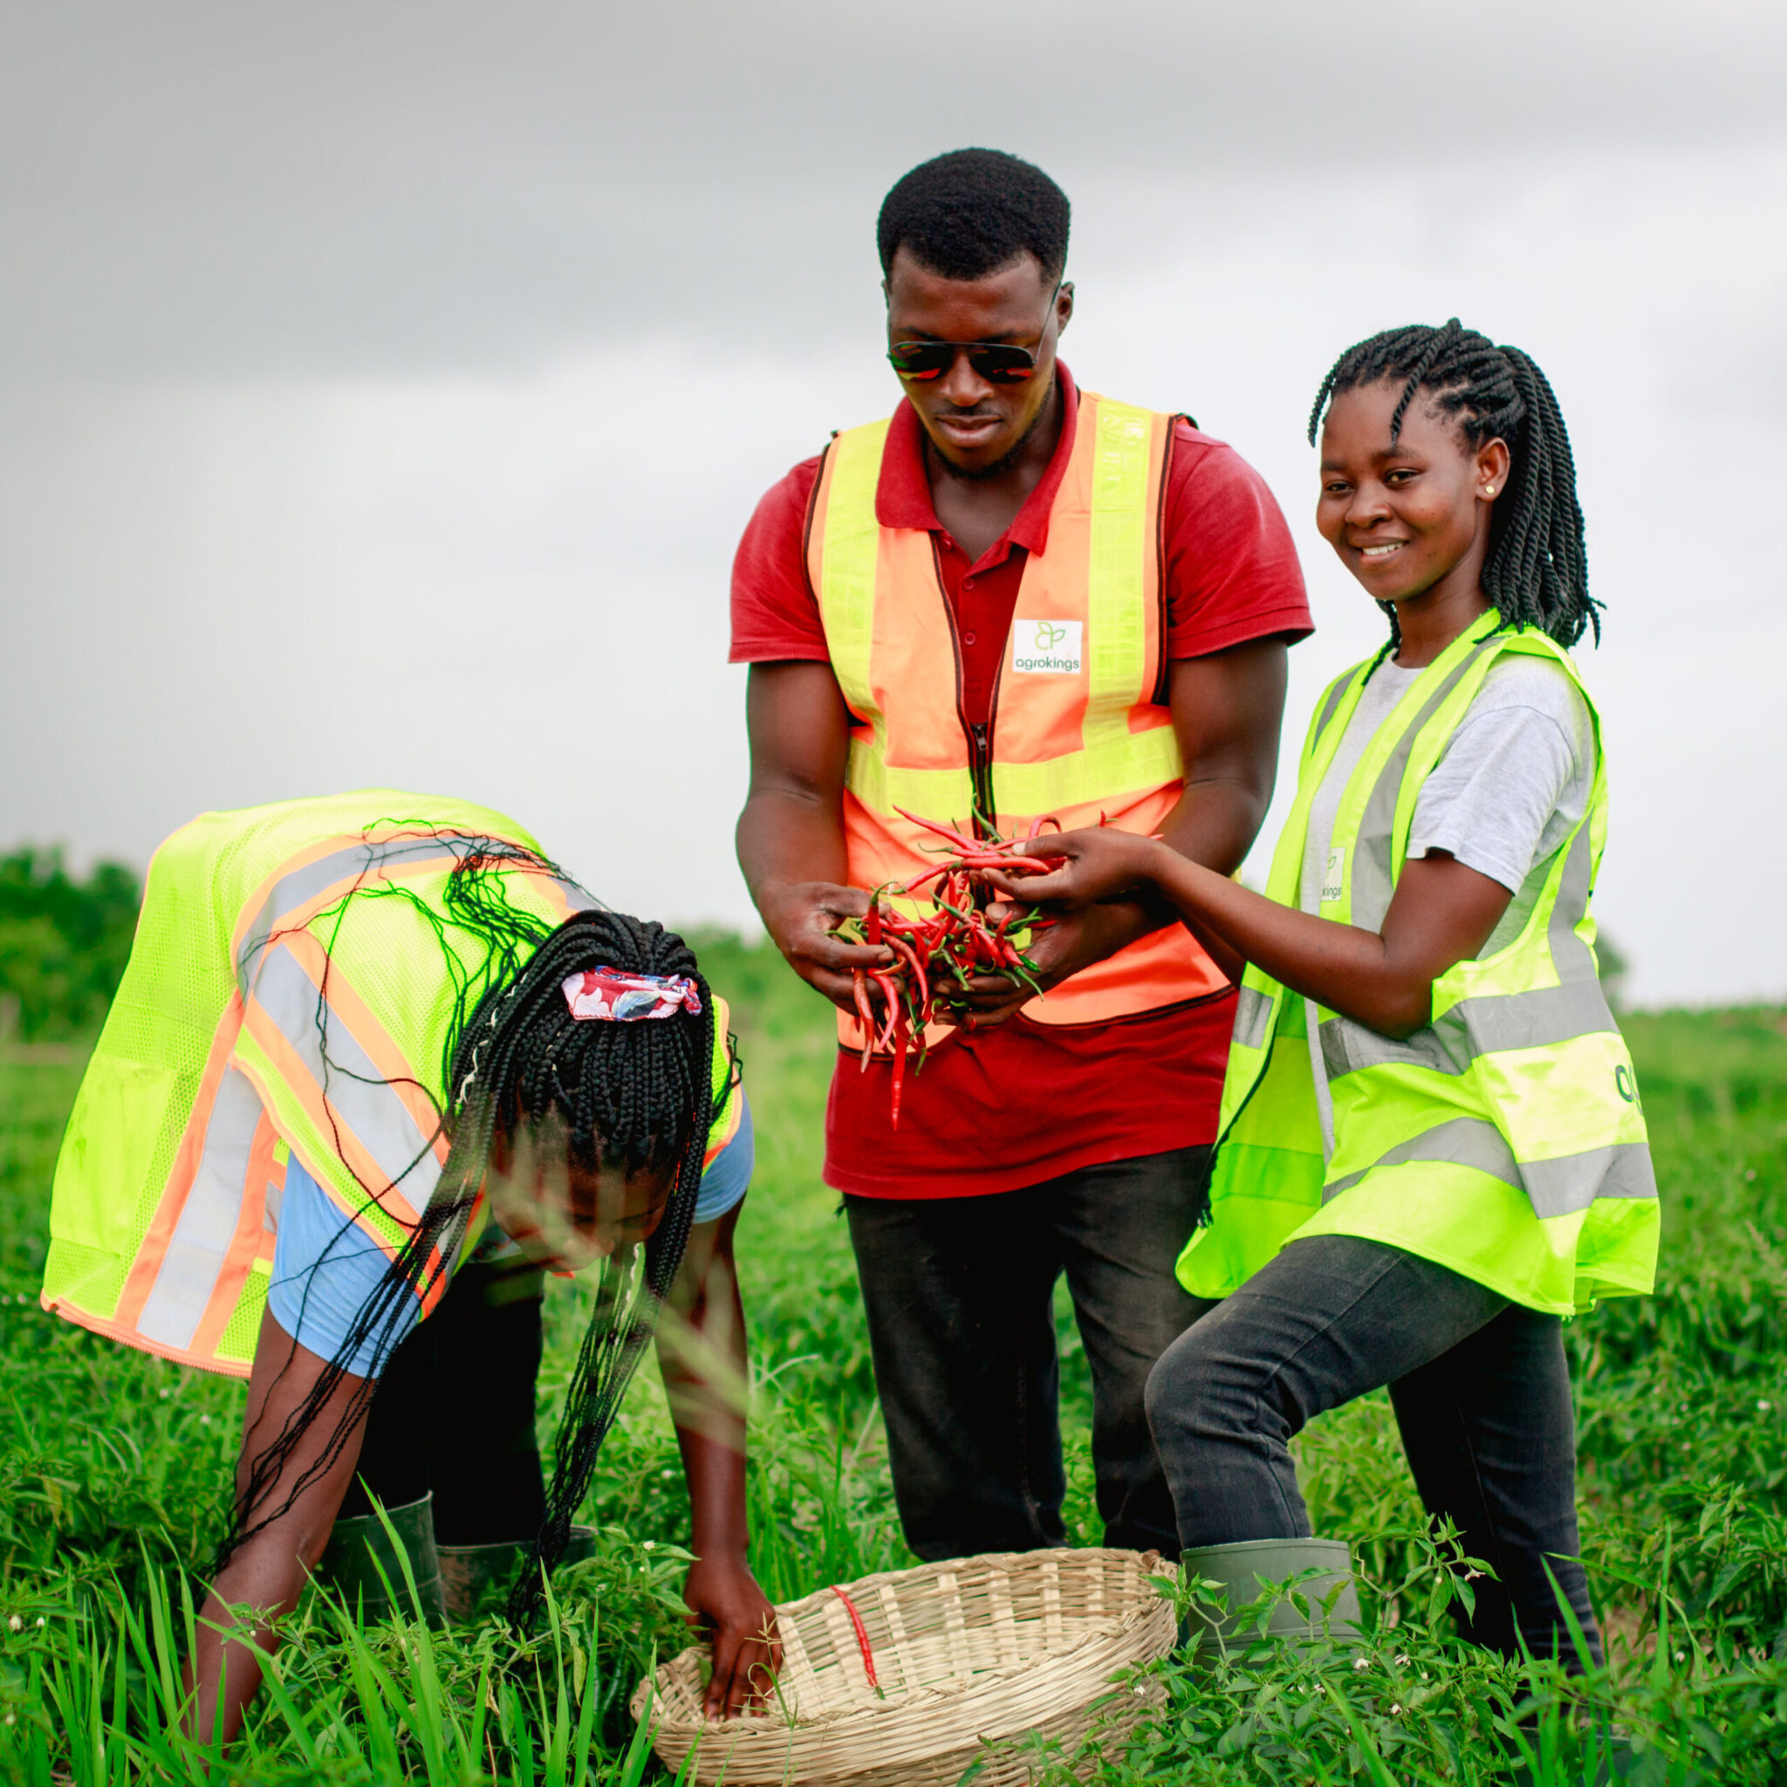
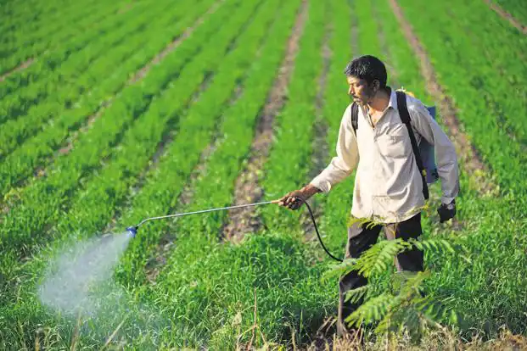
Introduction
The green revolution is a period of rapid technological advancements in agriculture that began in the mid 20th century.
It is also a period of intensive agricultural practices aiming to increase crop yields through the use of high - yielding varieties, mechanization and agro chemical inputs.
The primary goals of the green revolution
1. Increase food production
2. Improve crop varieties
3. Poverty reduction.
So we ask the question; Has the green revolution been a blessing or a curse to biodiversity?

Slide 4
Positive Impacts on Biodiversity
Increased agricultural productivity
The Green Revolution, utilizing high-yielding crop varieties and modern farming techniques, increased food production, met growing demand, and reduced ecosystem pressure, preserving biodiversity indirectly.
Conservation of natural habitats
By enhancing crop yields, the Green Revolution has helped prevent the conversion of additional land into agricultural fields. This has protected existing natural habitats from conversion, ensuring the preservation of diverse ecosystems and the species that rely on them.

Slide 5
Positive Impact on biodiversity cont’d
Reduced deforestation
The Green Revolution intensifies agriculture, reducing forest clearing, reducing deforestation, and preserving valuable ecosystems and inhabitants, reducing biodiversity loss.
Preservation of genetic diversity
The Green Revolution prioritized improved crop varieties while preserving traditional crop variety. This ensures genetic diversity, adaptation to changing conditions, and ability to respond well to fertilizers, pesticides and resistance to diseases.

Slide 6
Other Positive Impacts
Poverty reduction
Rural employment
Generating revenue from export of food products

Slide 7
Negative Impacts of the Green Revolution on Biodiversity
Loss of native crop varieties
The Green Revolution promoted high-yielding crop varieties, displacing traditional and locally adapted varieties, resulting in genetic diversity loss and reduced agricultural resilience to pests, diseases, and environmental changes.
Habitat destruction
The expansion of agricultural areas during the Green Revolution required the clearance of natural habitats such as forests, wetlands, and grasslands. This widespread habitat destruction has caused the loss of numerous plant and animal species, disrupting ecosystems and contributing to biodiversity decline.

Slide 8
Negative Impacts of the Green Revolution on Biodiversity
Water pollution and depletion
The Green Revolution's intensive farming practices, including chemical fertilizers and pesticides, have led to water pollution and depletion of freshwater resources, affecting aquatic biodiversity and ecosystems.
Disruption of ecological balance
The use of agrochemicals, can disrupt ecological balances within agricultural landscapes. This includes the decline of beneficial insects, soil organisms, and pollinators, which are essential for supporting biodiversity and maintaining ecosystem functions.

Slide 9
Balancing the Green Revolution and Biodiversity
These can also serve as mitigation strategies to the green evolution
Balancing the green revolution and biodiversity requires sustainable agricultural practices, such as agroecology and organic farming, that promote biodiversity conservation and resilience.
Biodiversity friendly farming practices
Encourage the adoption of sustainable agricultural practices that promote biodiversity conservation. This includes agroforestry, organic farming, integrated pest management etc.

Slide 10
Balancing the Green Revolution and Biodiversity cont’d
Conservation of native crop varieties
Promote the conservation and cultivation of native crop varieties that are well-adapted to local environments. This helps preserve genetic diversity and reduces reliance on a limited number of high-yielding varieties.
Collaboration between farmers, scientists, policymakers, and communities is crucial for developing and implementing strategies that harmonize the green revolution and biodiversity conservation

Slide 11
Balancing the Green Revolution and Biodiversity
Education and awareness
Raise awareness among farmers, policymakers, and the general public about the importance of biodiversity conservation and the potential negative impacts of certain agricultural practices.
Sustainable water management
Promote efficient water management practices in agriculture to reduce water consumption, minimize water pollution from agrochemical runoff, and maintain healthy aquatic ecosystems.

Slide 12
Case Study
One notable case study illustrating the blessings and the curses of the green revolution on biodiversity is the state of Punjab in India.
Punjab
Punjab, located in northern India, was one of the early success stories of the Green Revolution. In the 1960s and 1970s, the introduction of high-yielding varieties of wheat and rice, coupled with extensive use of fertilizers and irrigation, led to a dramatic increase in agricultural productivity. Punjab became known as the "Granary of India" and achieved food self-sufficiency.
Blessing.
1. Increased agricultural production
2. Economic growth
3. Poverty alleviation
4. Increase in the standard of living

Slide 13
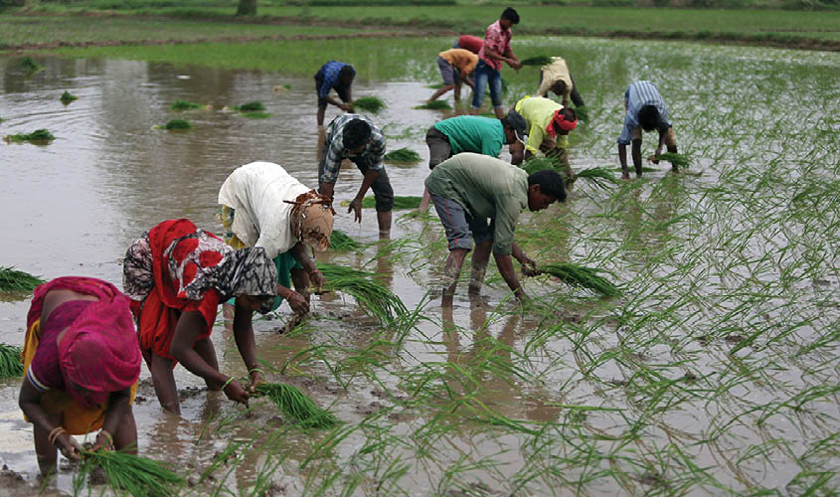
Case Study cont’d
Curses.
1. Loss of biodiversity
2. Water scarcity and pollution
3. Soil degradation
4. Cancer, renal failure, birth defects, etc.
Environmental Consequences
.1. Decline in beneficial insects and pollinators
2. Loss of indigenous crop varieties.
Conclusion.
The Green Revolution in Punjab brought both blessings and curses to biodiversity. While it significantly increased agricultural productivity and contributed to economic growth, it also led to the loss of biodiversity, soil degradation, water scarcity, and pollution.

Slide 14
Conclusion
While the green revolution has brought significant agricultural advancements and increased food production, it has also posed challenges to biodiversity conservation. Considering both the benefits and drawbacks, we believe the green revolution is a double-edged sword, necessitating a balanced approach to ensure sustainable practices and protect our precious ecosystem.

Slide 15
THANK YOU

Slide 16
References
Pingali, P. L. (2012). Green Revolution: Impacts, limits, and the path ahead. Proceedings of the National Academy of Sciences, 109(31), 12302-12308.
Tilman, D., et al. (2002). Agricultural sustainability and intensive production practices. Nature, 418(6898), 671-677.
Bala, B. K. (2010). Green Revolution and its impact on environment: An appraisal. International Journal of Environmental Sciences, 1(5), 1079-1092.
Smale, M., et al. (2011). The Green Revolution and wheat genetic diversity: Some unfounded assumptions. Food Policy, 36(6), 749-755.

Slide 17
Group Members
Adjei De-graft - 9195119
Oppong Ernest - 9215619
Amanin Kwarteng Abena Safowaa - 9198319
Adzrakor Gameli Richard - 9196319
Sarpong Awuraabena Sefah – 9218919
Idun Emmanuel Fiifi - 9209919
Anim Davilina – 9199919
Tawiah Antipas - 9219719
Abubakar Musah - 9193819

